Slide 1
Amazon Review Analysis

Slide 2


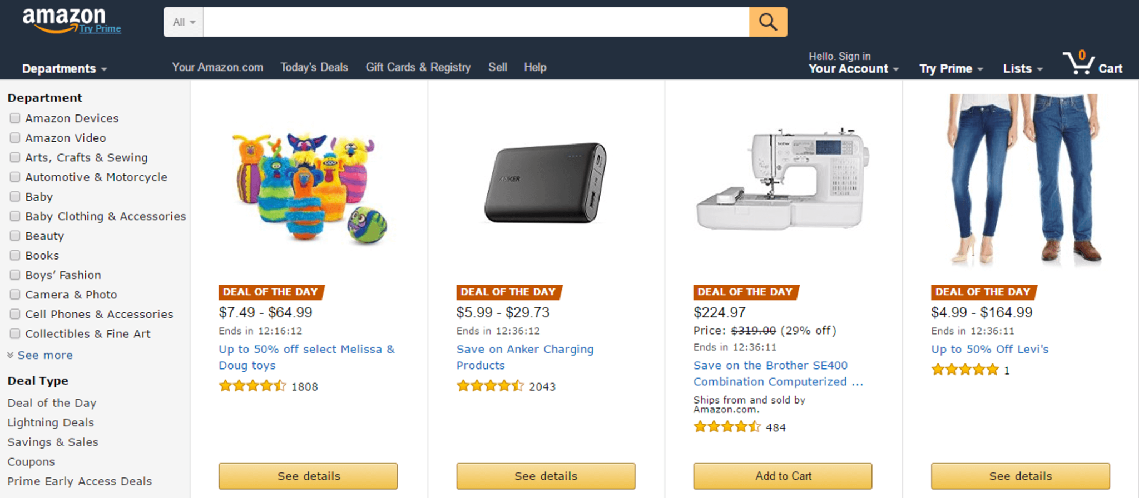
Introduction

Slide 3
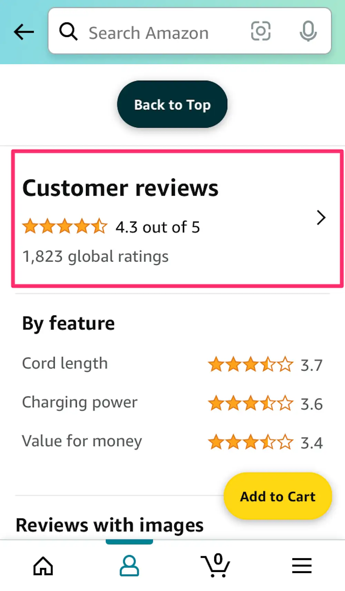
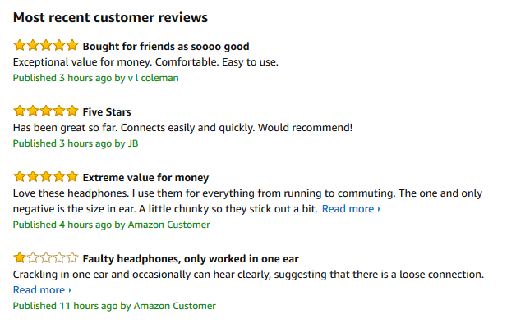
Positive Reviews

Slide 4
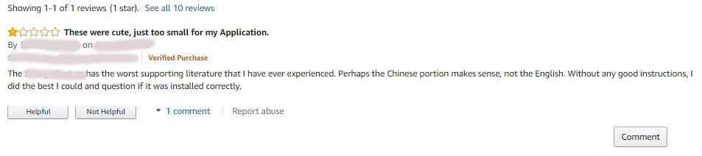
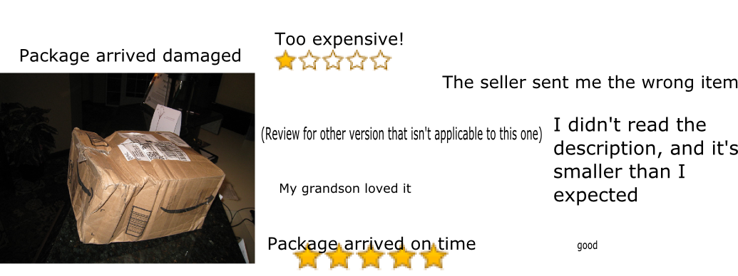
Negative reviews - Product Issue ; Seller Issue

Slide 5
Amazon Review of Clothing, Shoes and Jewelry Dataset from UCSD
asin - Unique ID of the product being reviewed
• helpful - A list with two elements: the number of users that voted, and the total number of users
• overall - The reviewer's rating of the product
• reviewText - The review text itself
• reviewerID - Unique ID of the reviewer
• reviewerName - The specified name of the reviewer
• summary - Headline summary of the review
• unixReviewTime - Unix Time of when the review was posted

Slide 6
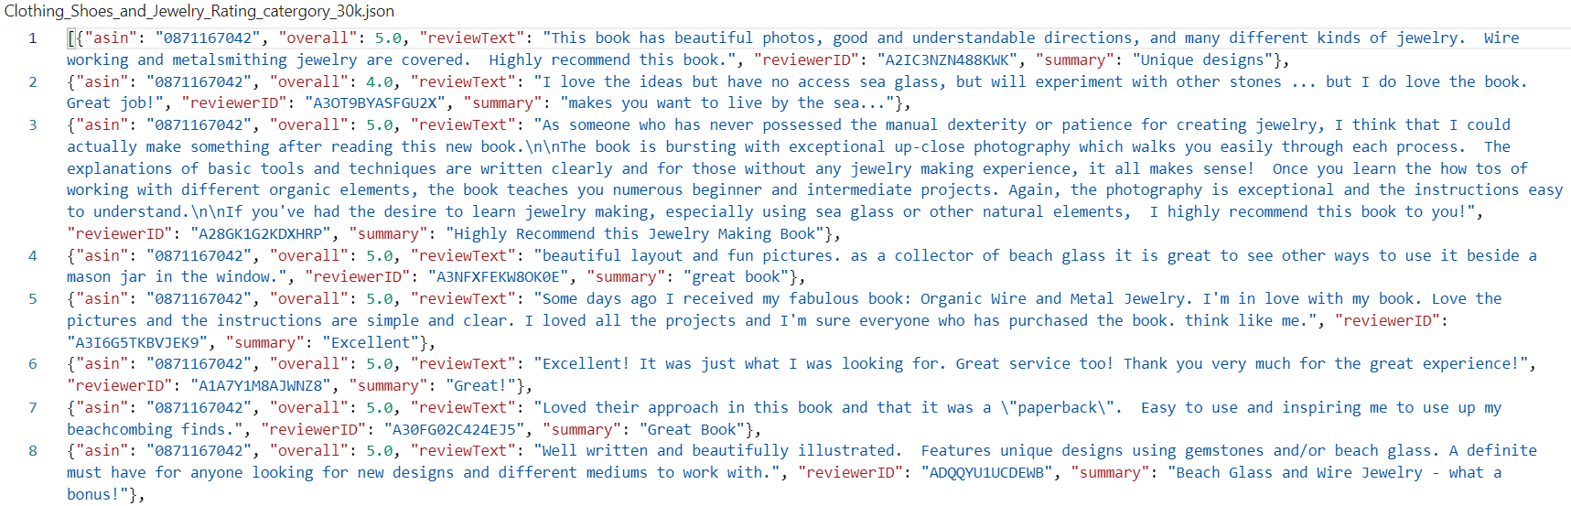

Slide 7
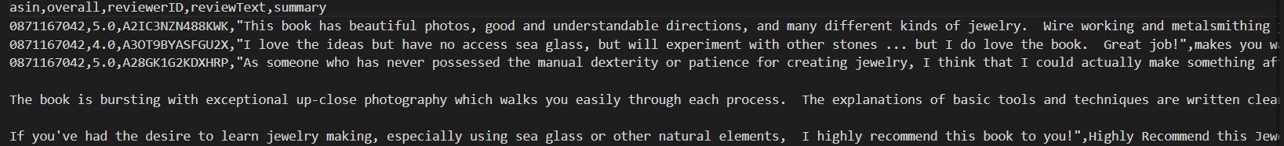
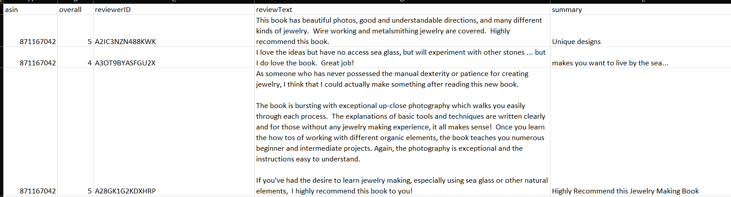
Data transformation- Json to CSV

Slide 8
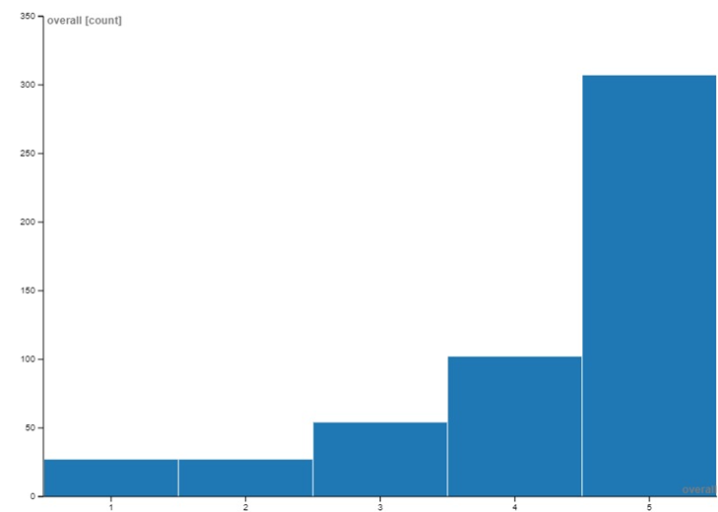
Visualisation:
The graph shows the number of ratings within each rating category in the dataset. It is mapped using the rating categories on x axis and the count of occurrence of each category of rating on y axis.

Slide 9
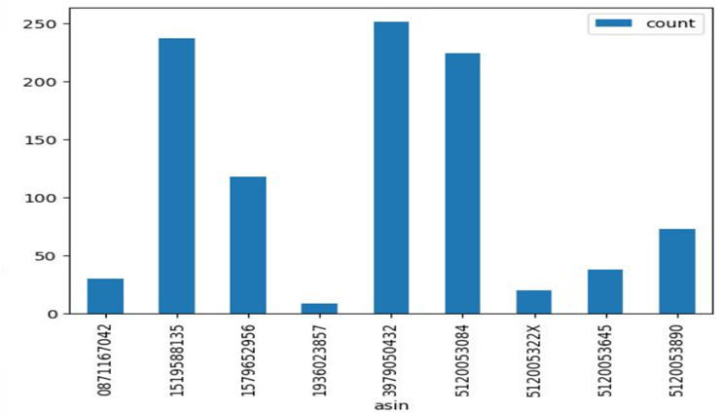
The graph shows the number of products with the asin id. It has the asin id on the x-axis and the count of that product on the y axis. This can be used to find out the number of items that are of similar type.

Slide 10
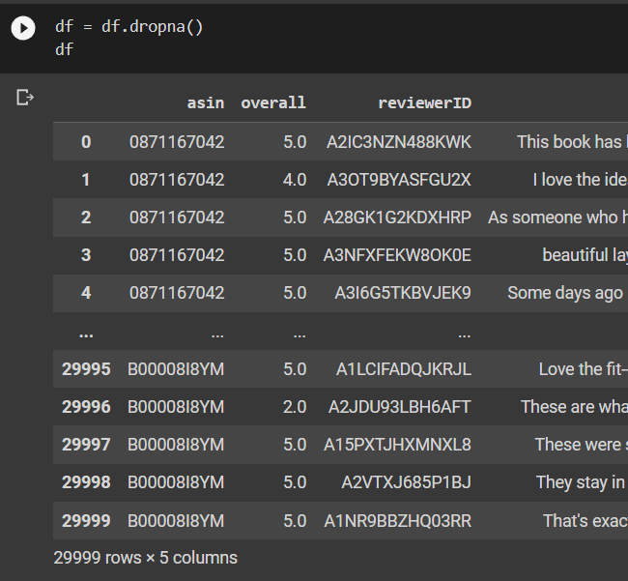
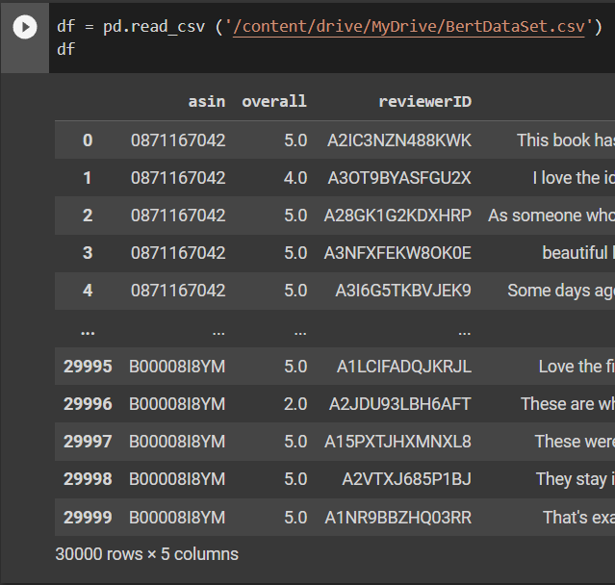
Data Cleaning and Tagging

Slide 11
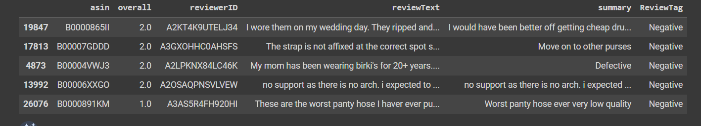
Positive review : overall rating >= 3
Negative review : overall rating < 3
Sort Values

Slide 12
Map-Reduce Positive and Negative Review
Categorize and identify number of positive and negative review in each product
Count number of positive review for a particular product
Count number of negative review for a particular product

Slide 13
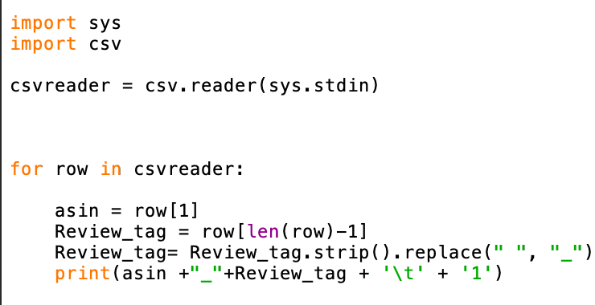
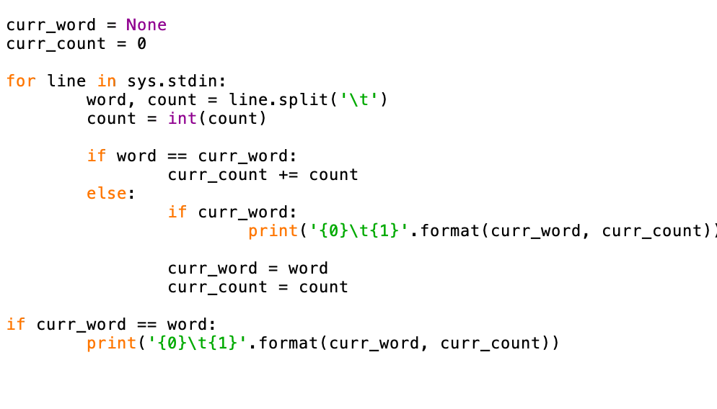

Slide 14
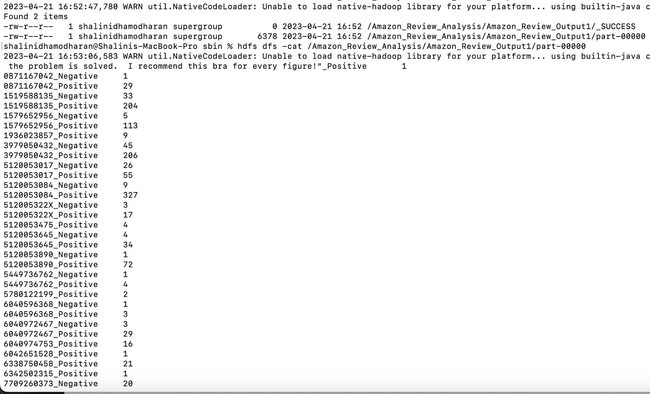
Output:

Slide 15
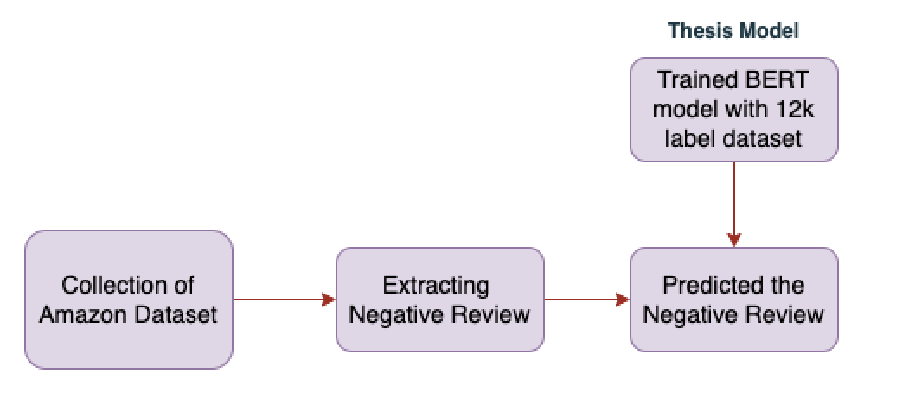
BERT : Bi-directional Encoder Representations for transformers
Amazon Review – Tagging Negative Review in Amazon
Dataset same - train model 12k UCSD
ReviewText and summary
Model : Topic Tagging
Amazon Review – Tagging
Negative Review in Amazon

Slide 16
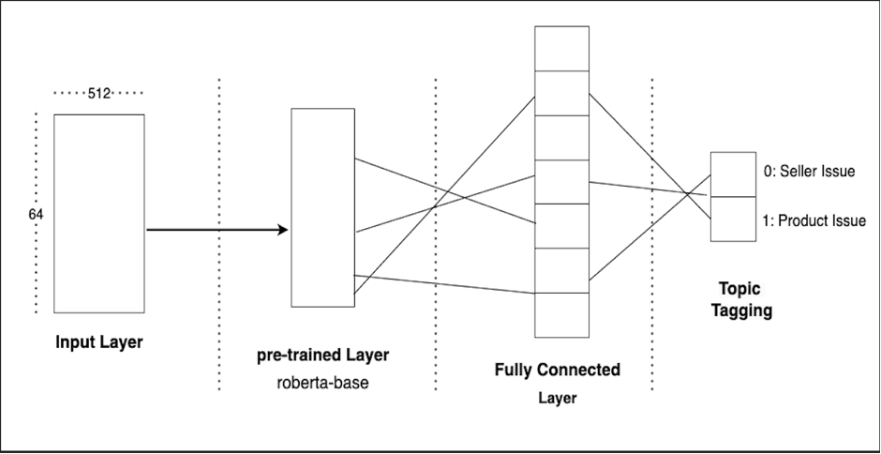
BERT : Bi-directional Encoder Representations for transformers Architecture

Slide 17
# Creating the customized model, by adding a drop out and a dense layer on top of distil bert to get the final output for the model.
class BERTClass(torch.nn.Module):
def __init__(self):
super(BERTClass, self).__init__()
self.roberta = AutoModel.from_pretrained('roberta-base')
self.fc = torch.nn.Linear(768,2)
def forward(self, ids, mask, token_type_ids):
_, features = self.roberta(ids, attention_mask = mask, token_type_ids = token_type_ids, return_dict=False)
output = self.fc(features)
return output
model = BERTClass()
model.to(device);

Slide 18
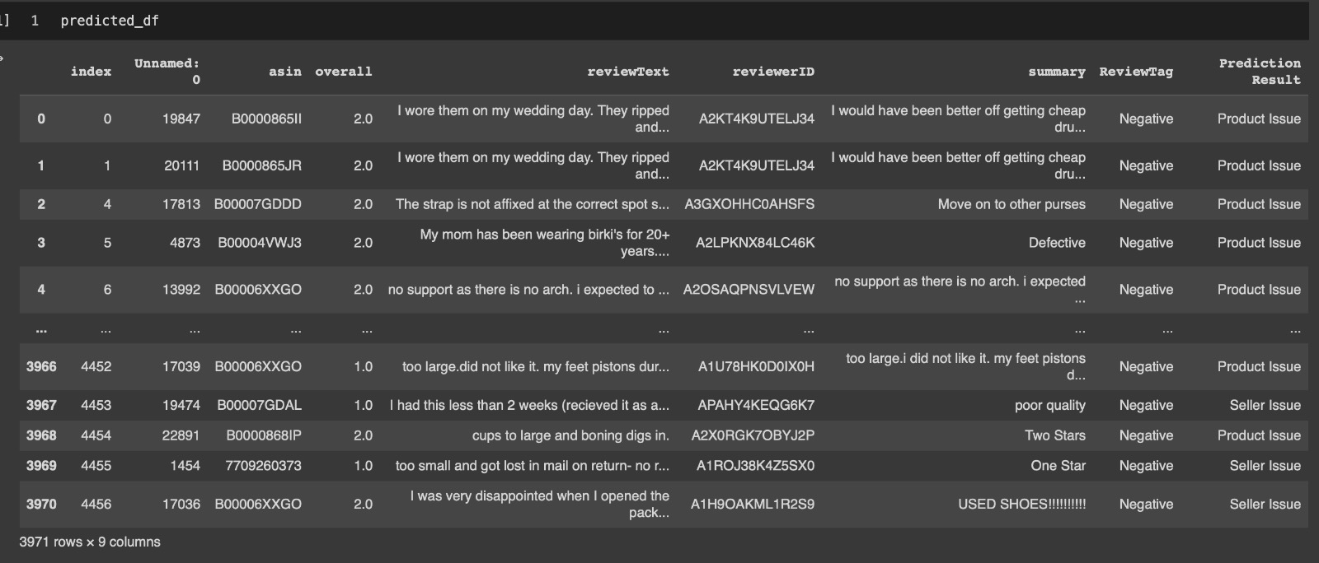
Integrate the machine learning model with negative ratings as input data and label the data as product or seller issue

Slide 19
Map-Reduce
Identify Negative Review Issue Types
Map and reduce the product and seller issue
Count number of seller issus
Count number of product issues

Slide 20
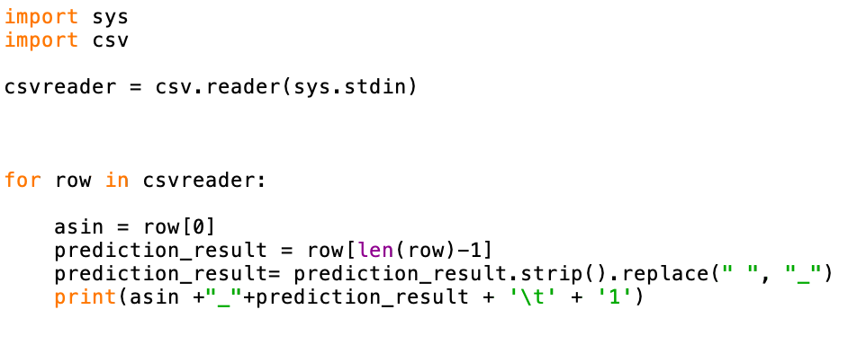
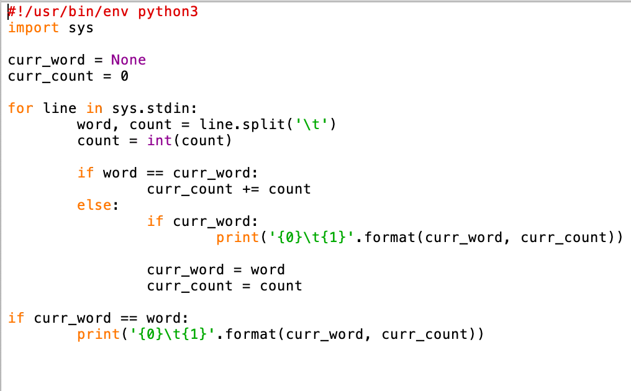

Slide 21
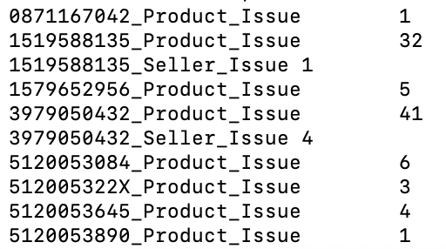
Output:

Slide 22
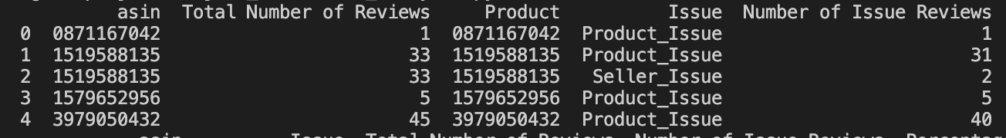
Dataframe Joins
Process and load the Map - Reduce Output in Pandas
Join Map-Reduce output dataframe and the original input dataframe
The dataframe join will help in identifying the products with higher Product Issue and Seller Issue

Slide 23
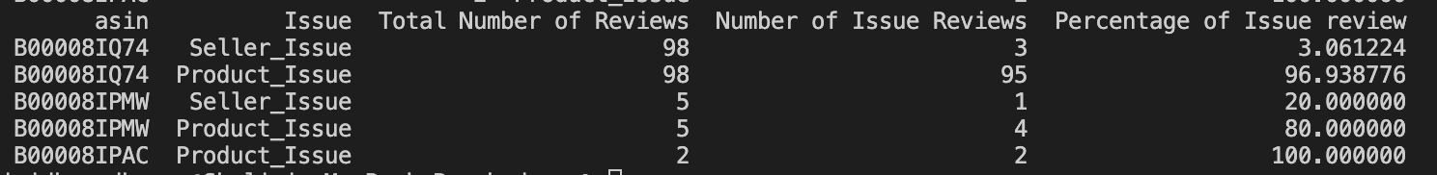
Impact of Negative Review and Percentage
df_sorted['Percentage of Issue review'] = 100 * df_sorted['Number of Issue Reviews']/df_sorted['Total Number of Reviews']

Slide 24
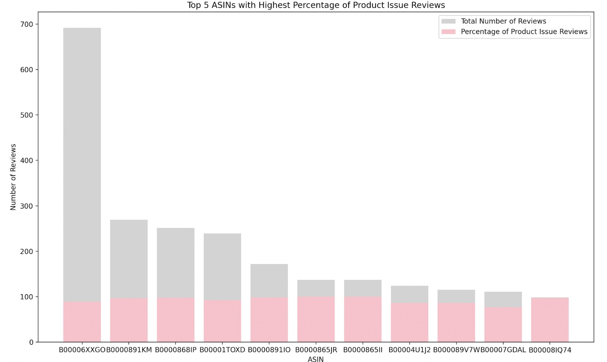
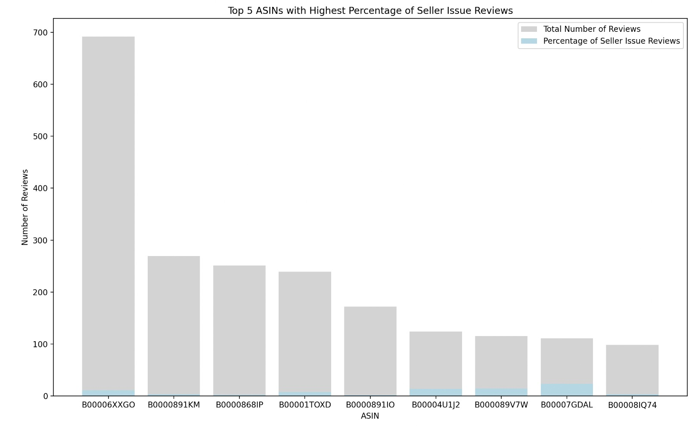
Percentage of product Issue
Percentage of Seller Issues

Slide 25
Future Direction:
· Model: Input data formats can be expandable.
· Research for varied categorical problems under each of the issues.
· The analysis of ratings: This will help identify top-selling products and top reviewers who do frequent reviews. (Identifying the top-selling products and frequent reviewers can be accomplished by conducting an analysis of the ratings.)
· Filtering Fake/False review: we believe every customer might share only legit reviews, there might be certain people who might make false comments. By finding frequent reviewers, we could categorize the ones who make false negative reviews on all the products. (We believe that each customer provides only genuine reviews; there is a possibility that some individuals may submit fake comments. Identifying frequent reviewers makes it possible to categorize those who post false negative reviews across all products.)

Slide 26
Any Questions ?

Slide 27
Thank You

